Slide 1


Cybersecurity Awareness Chatbot
Aashiq presents a console-based interactive assistant. Designed for cybersecurity education. Presented on March 19th, 2025. Focus on awareness and practical skills.
by Aashiq Petersen

Slide 2
Combating Cyber Threats in South Africa
Rising Cyber Threats
Chatbot Solution
South Africa faces increased cyber threats. Common threats include phishing, malware, and identity theft. These attacks target individuals and organizations.
The Cybersecurity Awareness Chatbot helps educate users. It covers key cybersecurity topics. This is developed as a C# Console Application.

Slide 3
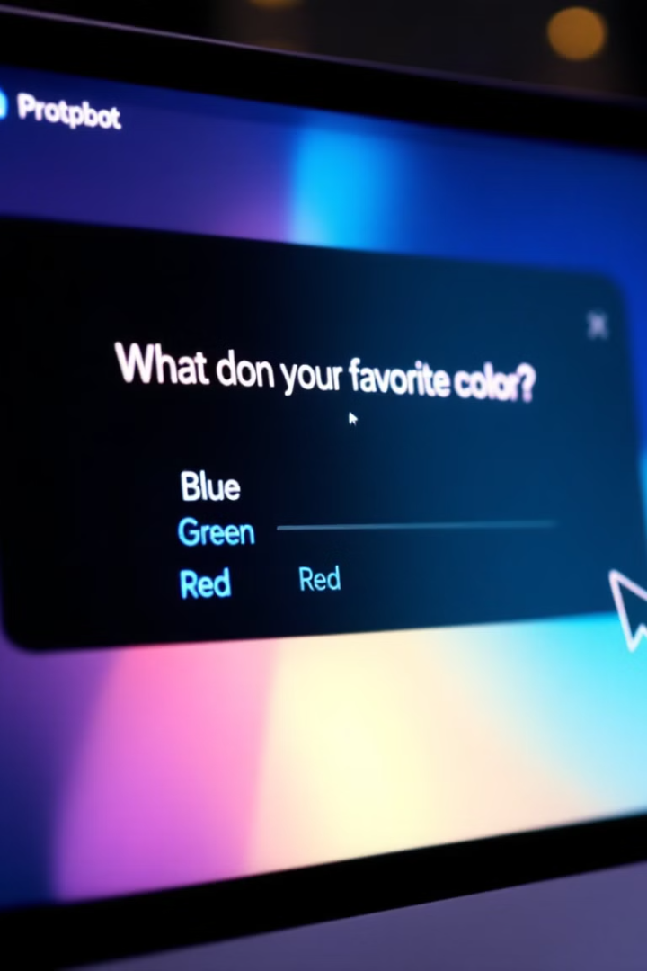
Chatbot Objectives
1
User-Friendly Education
Provide cybersecurity education in an accessible way.
2
Interactive Conversations
Offer interactive dialogues with predefined responses.
3
Multimedia Elements
Integrate voice greetings, ASCII art, and color.
4
Version Control
Use GitHub for version control and CI/CD.

Slide 4
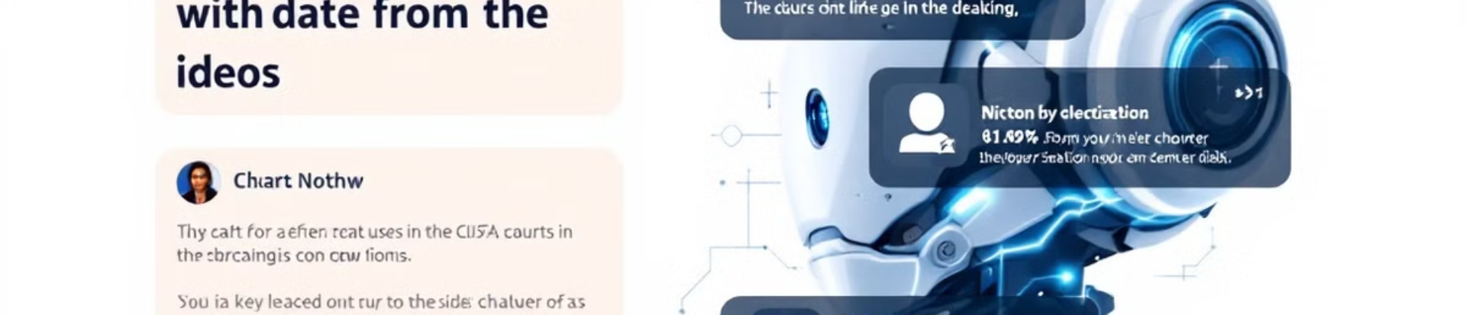





Key Features Overview
Voice Greeting
ASCII Art Logo
Personalized Interaction
Cybersecurity Q&A
Plays a pre-recorded WAV file for a welcome message.
Displays a themed banner.
Customizes responses based on user input.
Educates on passwords, phishing, and browsing.

Slide 5
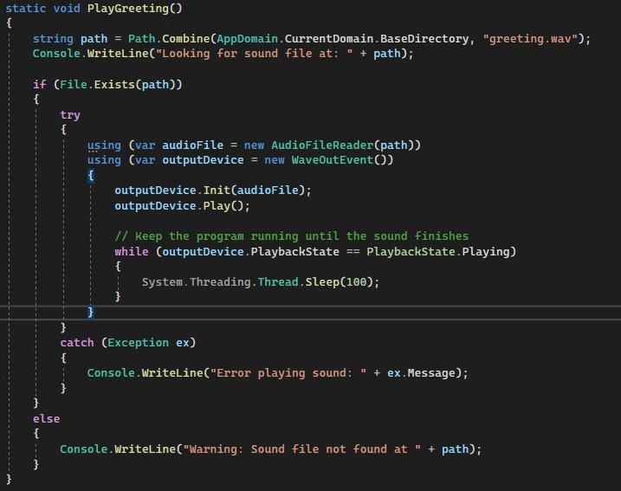
Code Walkthrough - Voice Greeting
1
Audio Integration
Incorporating audio into the application.
2
File Handling
Managing WAV files for playback.
3
Execution
Playing the audio upon application startup.

Slide 6
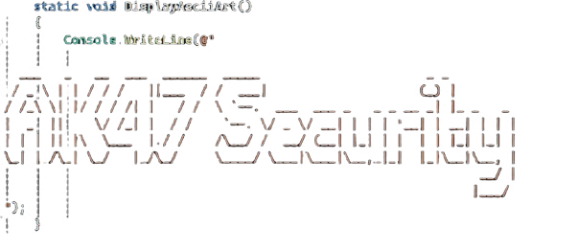
Code Walkthrough - ASCII Art

Slide 7



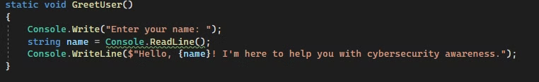
Code Walkthrough - User Interaction
Input
1
Gathering data from the user.
Validation
2
Verifying the entered data.
Response
3
Generating personalized replies.

Slide 8



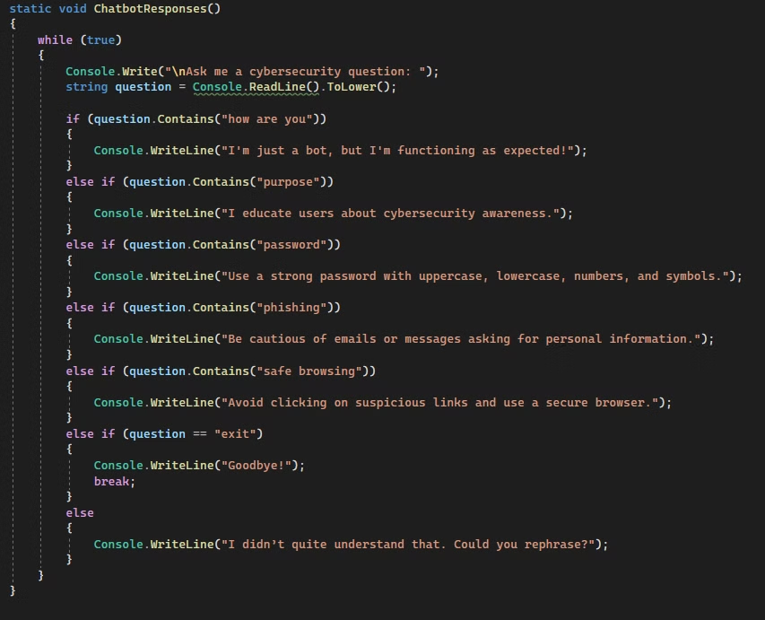
Code Walkthrough - Chatbot Response System
2
Logic
Applying decision-making rules.
Data
1
Retrieving information from sources.
Delivery
Presenting the response to the user.
3

Slide 9
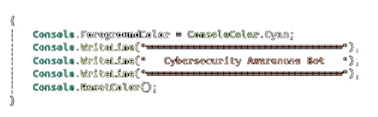
Code Walkthrough - Console Formatting

Slide 10
Demonstration
✅ Live Demo of the Chatbot
Run the chatbot and show:
- Voice greeting.
- ASCII art display.
- Personalized user interaction.
- Response to cybersecurity questions.

Slide 11

End
Thank you

Slide 12
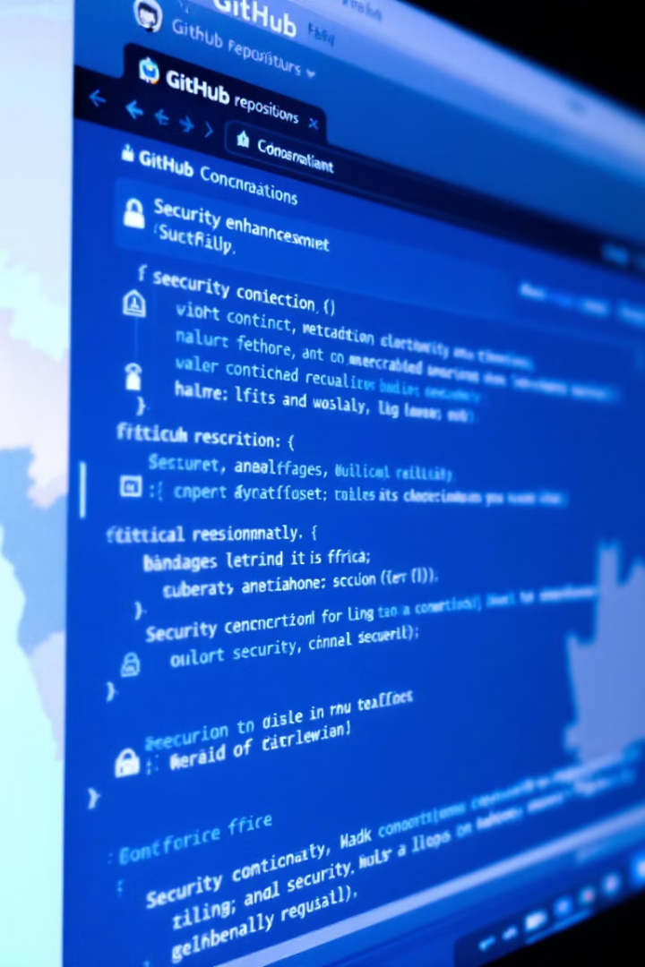
GitHub & CI Integration
1
Version Control
GitHub stores project versions and history.
2
Commits
Track changes with clear messages. For example, "Added voice greeting and ASCII art".
3
CI/CD
Automates build and syntax checks using GitHub Actions.

